Slide 1
E-MaRK Emergency Medical support & Record Keeping system
P.G. Amila Sampath Pelaketigamage
Department of Electrical & Electronic Engineering

Slide 2


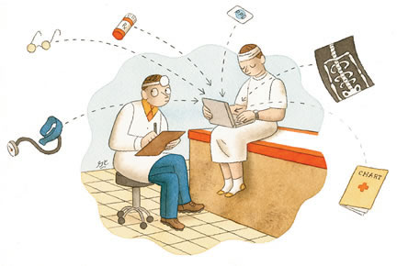
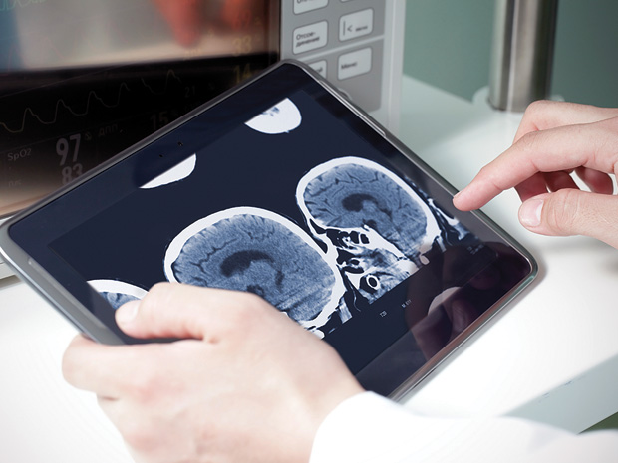
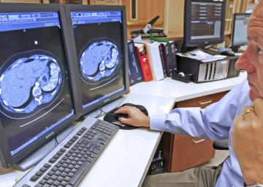
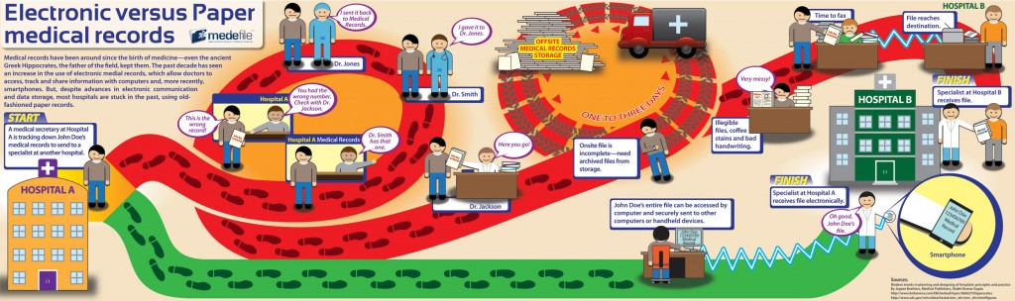
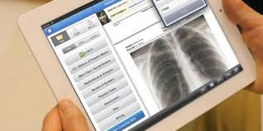

Slide 3
System Overview
Doctor’s Input
Main Server
Doctor
View
Patient’s Inputs
User
View
Machine’s Input
Take Reports

Slide 4

?

Slide 5


